Slide 1


PAAVAI ENGINEERING COLLEGE
(AUTONOMOUS)
DEPARTMENT OF INFORMATION TECHNOLOGY
AI APP FOR FARMER
Batch 2
PRESENTED by:
A.AJAY(20202002)
J.KARRAN(20202027)
A.NAVEEN(2020233)
Final Year IT
Paavai Engineering College
GUIDED by:
Mrs.B.DEEPA,M.E,
Assistant professor,
Department of IT,
Paavai Engineering College

Slide 2
INTRODUCTION
The proposed mobile app is a comprehensive solution leveraging Artificial Intelligence (AI) and advanced data analytics to revolutionize agriculture by optimizing farming inputs.
By analyzing various factors such as soil health, weather conditions, and crop history, the app generates personalized recommendations for optimal agricultural practices.
These recommendations aim to enhance crop yields and sustainability while minimizing resource usage.
Additionally, the app provides real-time feedback on crop yields, allowing farmers to make informed decisions and improve overall productivity.

Slide 3
INTRODUCTION
The wrong combination of nutrients in soil can seriously affect the health and growth of crops. Identifying these nutrients and determining their effects on crop yield with AI allows farmers to easily make the necessary adjustments.
While human observation is limited in its accuracy, computer vision models can monitor soil conditions to gather accurate data. This plant science data is then used to determine crop health, predict yields while flagging flag any particular issues.
These recommendations aim to enhance crop yields and sustainability while minimizing resource usage.
Additionally, the app provides real-time feedback on crop yields, allowing farmers to make informed decisions and improve overall productivity.

Slide 4
Objective
The objective of implementing an AI app for farmers is to leverage advanced technologies to address key challenges and optimize agricultural practices. The app aims to provide farmers with valuable insights, decision support, and actionable recommendations across various aspects of farm management.
By integrating machine learning algorithms and artificial intelligence techniques, the app can analyse diverse datasets, including weather data, soil health indicators, crop performance metrics, and market trends, to deliver personalized recommendations and predictions tailored to the specific needs and conditions of individual farmers.
Through intuitive user interfaces, interactive features, and real-time updates, the app seeks to empower farmers with the knowledge, tools, and resources they need to enhance productivity, minimize risks, and maximize profitability in their farming operations.

Slide 5
Technology Used
Machine Learning Algorithms
Data Analytics
AI-driven Decision Support System
Cloud Computing
Flutter

Slide 6
Aim Of The Project
The primary objective of this mobile app is to empower farmers with cutting-edge technology, specifically Artificial Intelligence (AI) and data analytics, to optimize agricultural inputs and enhance crop yields.
The app seeks to provide personalized and data-driven recommendations for optimal farming practices based on a through analysis of various factors such as soil health, weather conditions, and historical crop performance.

Slide 7
Proposed System
Data Collection Module
Data Processing and Analytics
AI Recommendation Engine
Educational Resources

Slide 8
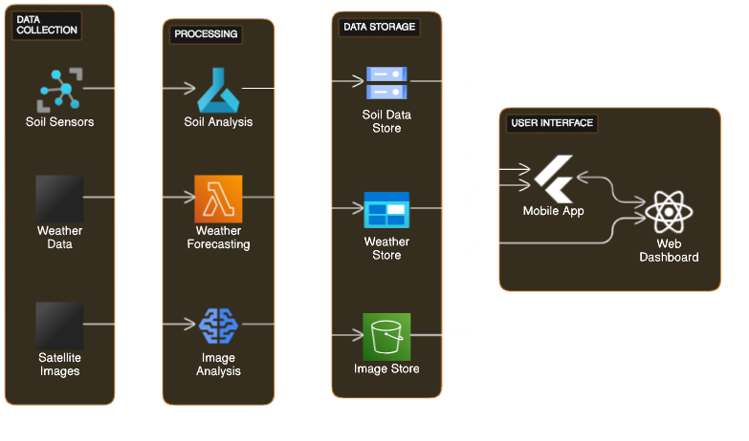
System Architecture

Slide 9
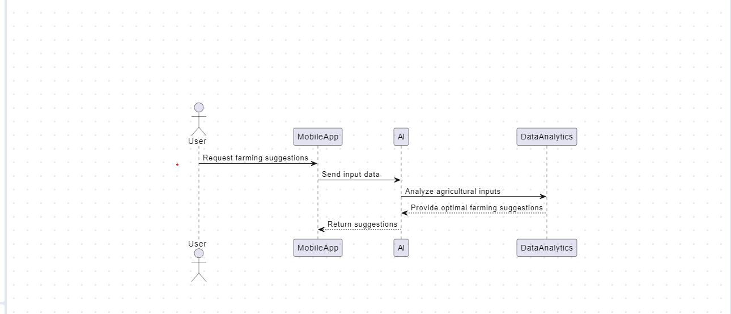
Sequence Diagram

Slide 10
AI Recommendation Engine
Farm Management
Field Insights
Yield Monitoring and Prediction
Crop Health Monitoring
AI engine can assess crop health by analyzing imagery captured by drones or satellites. It can detect signs of stress, nutrient deficiencies, pest infestations, and diseases early on, enabling proactive management strategies to mitigate risks and protect crop yields.

Slide 11
AI Recommendation Engine
Decision Support
It provides decision support tools that help farmers make data-driven decisions.
By aggregating and analyzing vast amounts of data, including historical records, weather forecasts, and market trends, the platform offers recommendations on crop selection, planting dates, irrigation scheduling, and input optimization.

Slide 12
Algorithm
Step 1: Image Acquisition
Ensure proper image resolution and quality to capture detailed information about crops and soil conditions.
Step 2: Pre-processing
Remove noise and artifacts from the images to enhance clarity.
Correct for distortions, such as lens distortion or uneven lighting, to ensure accurate analysis.
Normalize the images to standardize brightness and color levels across different scenes.

Slide 13
Algorithm
Step 3: Segmentation
Segment the images into relevant regions of interest (ROIs), such as crop rows, soil areas, and weeds.
Utilize segmentation techniques such as thresholding, clustering, or edge detection to distinguish between different elements in the image.
Step 4: Weed Detection and Management
Detect and classify weeds within the agricultural fields based on image characteristics.
Integrate weed detection results with precision herbicide application systems for targeted weed control.

Slide 14
Algorithm
Step 5: Yield Prediction
Use image-derived features, such as crop density, canopy structure, and flowering patterns, to predict crop yields.
Train predictive models using historical yield data and image-based metrics to forecast future crop production.
Step 6: Data Integration and Analysis:
Integrate image processing results with other data sources, such as weather data, soil samples, and agronomic practices.
Analyze combined datasets to gain insights into the factors influencing crop performance and optimize agricultural management strategies.

Slide 15
Machine learning algorithms
Convolutional Neural Networks (CNNs)
Convolutional Neural Networks are a class of deep learning models commonly used for image recognition and classification tasks.
CNNs can analyze images of crop leaves or fruits to detect symptoms of diseases, pests, or nutrient deficiencies.
By learning features such as patterns, textures, and colors associated with different diseases or pests, CNNs can accurately classify the health status of crops and provide early warnings to farmers about potential threats.

Slide 16
Gradient Boosting Machines
GBM can analyze sensor data or images of crops to detect symptoms of diseases, pests, or nutrient deficiencies.
GBM can predict weather conditions and assess the risk of extreme weather events such as droughts, floods, or frost based on historical weather data.
Gradient Boosting Machines is a machine learning technique that builds predictive models in the form of an ensemble of weak prediction models, typically decision trees

Slide 17
Principal Component Analysis (PCA)
GBM can analyze sensor data or images of crops to detect symptoms of diseases, pests, or nutrient deficiencies.
GBM can predict weather conditions and assess the risk of extreme weather events such as droughts, floods, or frost based on historical weather data.
Gradient Boosting Machines is a machine learning technique that builds predictive models in the form of an ensemble of weak prediction models, typically decision trees

Slide 18
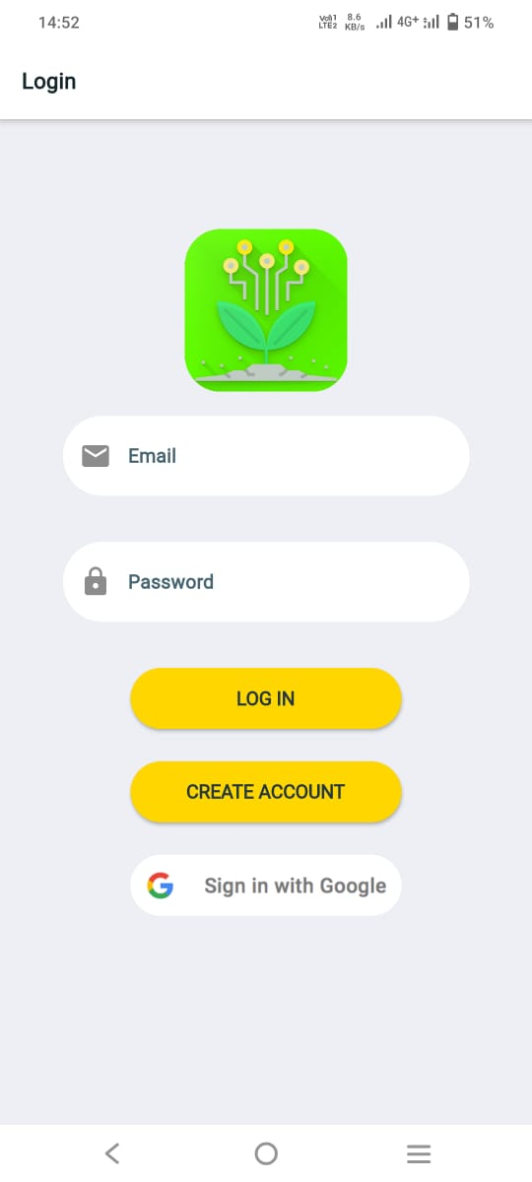
MODULES LOGIN

Slide 19
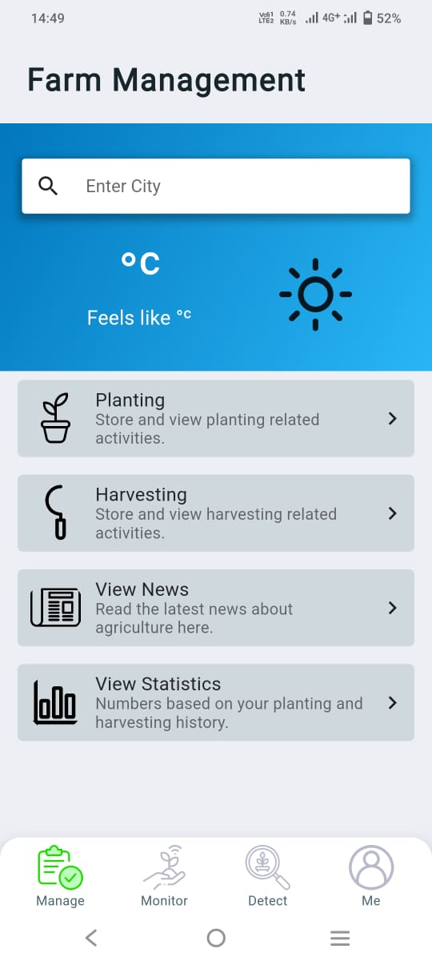
FARM MANAGEMENT

Slide 20
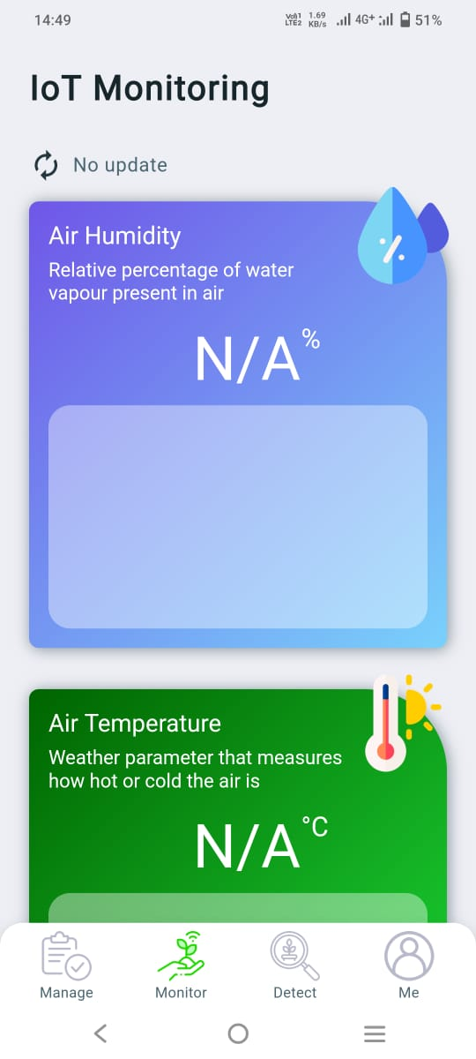
IOT MONITORING

Slide 21
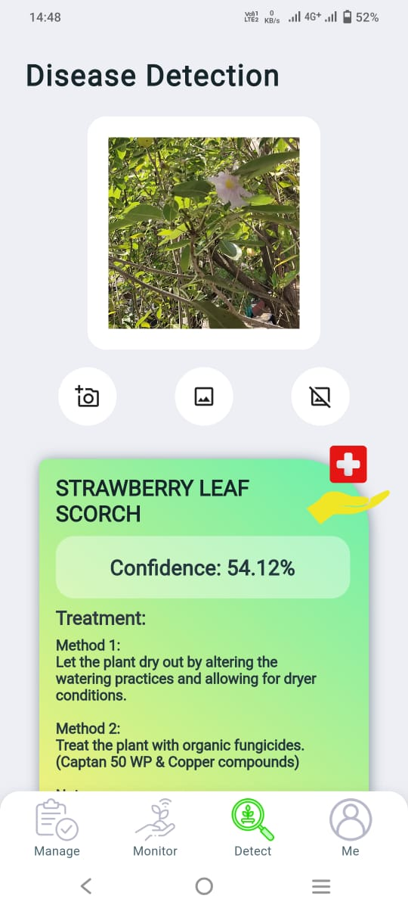
DISEASE DETECTION

Slide 22
THANK YOU

